Slide 1
Tutorial
CSE - 6339
Presented by:
Jisa Sebastine

Slide 2


Slide 3
Apache Spark
Open Source cluster computing framework
cluster manager (Standalone, YARN, Mesos)
distributed storage system
(HDFS,AmazonS3, psuedo disributed local mode)
In-memory primitives
Load data into a cluster's memory

Slide 4
Originally developed in the AMPLab at UC Berkeley
465 contributors in 2014
most active project in the Apache Software Foundation
Java, Scala, and Python APIs.
Ability to cache datasets in memory
Higher level library for stream processing, through Spark Streaming.
Support for structured and relational query processing (SQL), through Spark SQL
Higher level libraries for machine learning and graph processing

Slide 5
Hortonworks Sandbox 1.3 (http://hortonworks.com/products/hortonworks-sandbox/#install)
ssh root@127.0.0.1 -p 22
wget http://apache.spinellicreations.com/spark/spark-1.3.0/spark-1.3.0.tgz
tar xvfz spark-1.3.0.tgz
sbt/sbt assembly
set environment variables

Slide 6
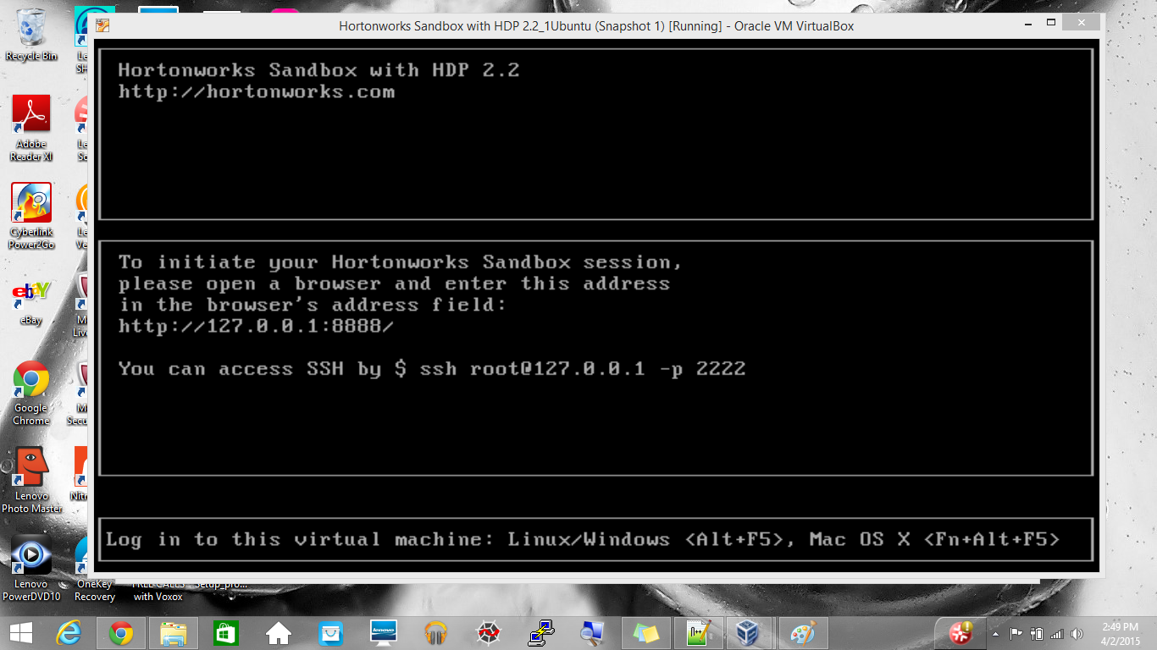

Slide 7
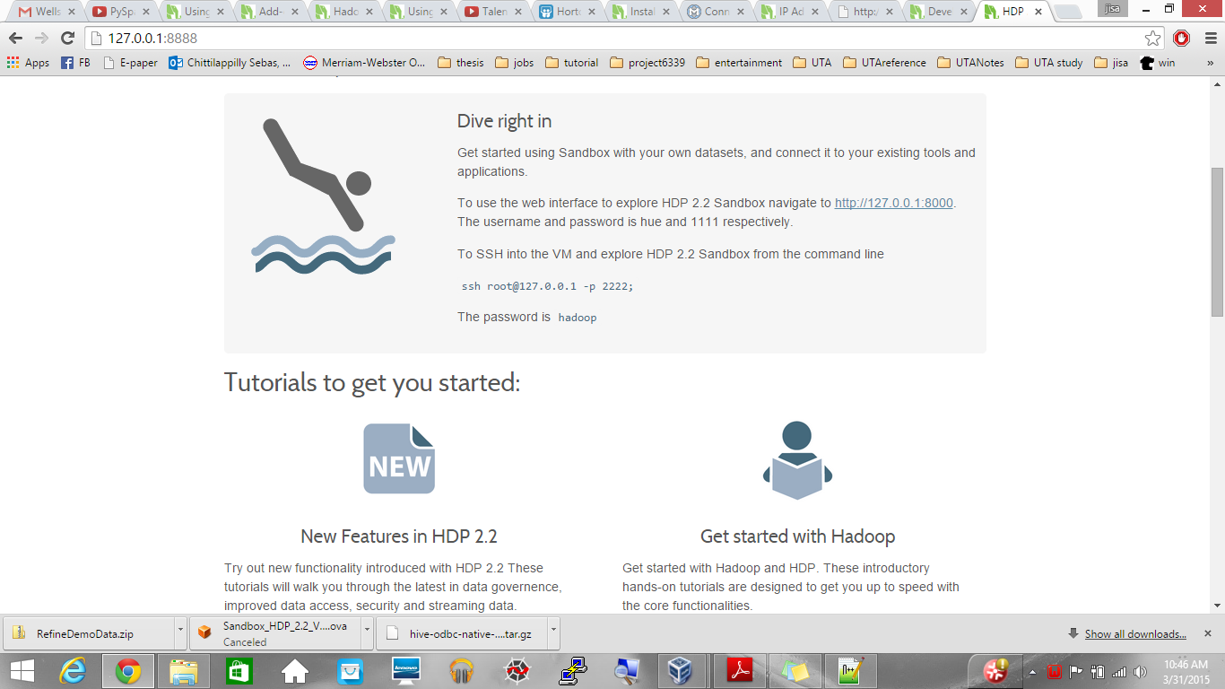

Slide 8
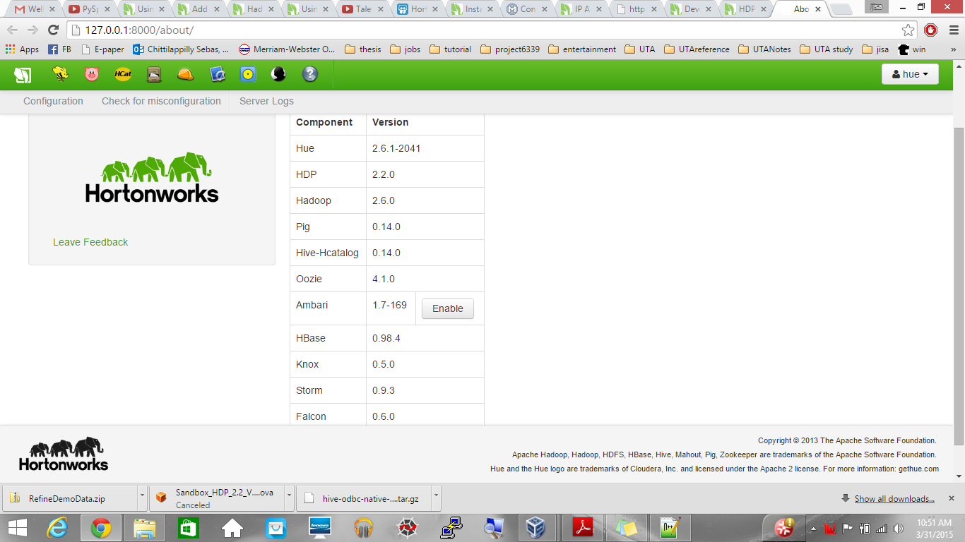

Slide 9
[root@sandbox]#/root/<SPARK_HOME>/sbin/start-master.sh
[root@sandbox]#/sbin/start-master.sh
check the webUI and get the spark://URL
decide the master and workers
create worker
[root@sandbox]# ./bin/spark-class org.apache.spark.deploy.worker.Worker <spark://url>
submit applications from master
[root@sandbox]# ./bin/spark-submit <filename> --master <master-url>

Slide 10
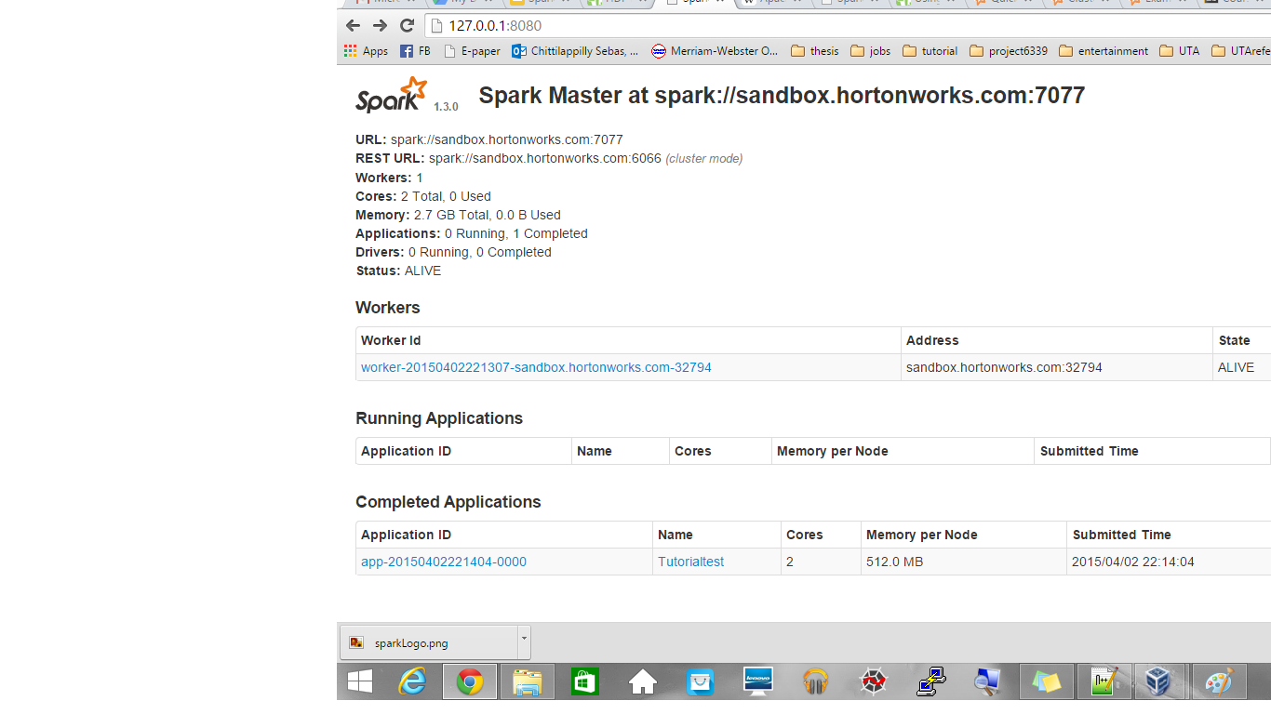

Slide 11
SparkContext
Main entry point for Spark functionality.
A SparkContext represents the connection to a Spark cluster, and can be used to create RDDs, accumulators and broadcast variables on that cluster
RDD
textfile as an RDD
lines = sc.textFile("README.md") # Create an RDD called lines >>> lines.count() # Count the number of items in this RDD 127 >>> lines.first() # First item in this RDD, i.e. first line of README.md u'# Apache Spark'

Slide 12
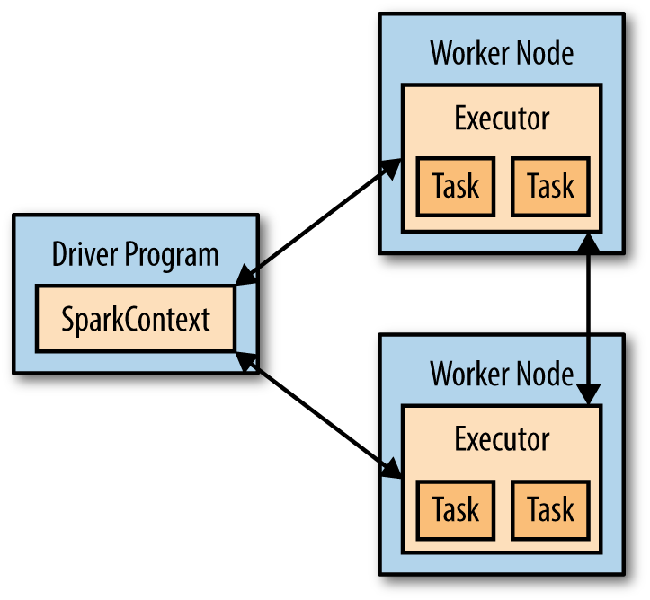
The Spark way of doing count()

Slide 13
filter option
lines = sc.textFile("README.md") >>> pythonLines = lines.filter(lambda line: "Python" in line) >>> pythonLines.first() u'## Interactive Python Shell'
union option
errorsRDD = inputRDD.filter(lambda x: "error" in x) warningsRDD = inputRDD.filter(lambda x: "warning" in x) badLinesRDD = errorsRDD.union(warningsRDD)
Notes:
lambda is a shorthand way to define functions inline in Python and Scala.

Slide 14
Demo

